Slide 1
Classes and Objects
LAD
Presented By
Mr. L. Atri Datta Ravi Tez
Assistant Professor
Dept of CSE

Slide 2

Introduction
LAD
What is an Object?
An object in Java is the physical entity, whereas, a class in Java is a logical entity only.
An entity that has state and behavior is known as an object e.g., chair, bike, marker, pen, table, car, etc. It can be physical or logical (tangible and intangible). The example of an intangible object is the banking system.
An object has three characterstics
1. State
2. Behaviour
3. Identity

Slide 3
Classes and Objects
LAD
State: represents the data (value) of an object.
Behavior: represents the behavior (functionality) of an object such as deposit, withdraw, etc.
Identity: an object identity is typically implemented via a unique id. The value of the ID is not visible to the external user. However, it is used internally by the JVM to identify each object uniquely.
For Example, Pen is an object. Its name is Parker; color is black, known as its state. It is used to write, so writing is its behavior.
An object is an instance of a class. A class is a template or blueprint from which objects are created. So, an object is the instance(result) of a class.

Slide 4
Definition of a Object
LAD
An object is a real world entity
An object is a runtime entity
The object is an entity which has state and behavior.
The object is an instance of a class.

Slide 5
Classes and Objects
LAD
What is a class in java?
A class is a group of objects which have common properties. It is a template or blueprint from which objects are created. It is a logical entity. It can't be physical.
A class in java can contain:
Fields
Methods
Constructors
Blocks
Nested class and interface

Slide 6
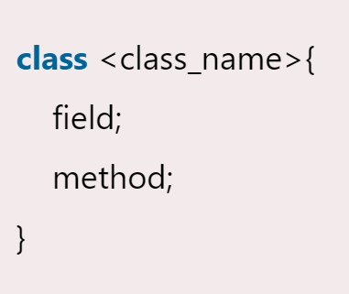
Classes and Objects
LAD
Syntax to declare a class:

Slide 7
Classes and Objects
LAD
New keyword in java
The new keyword is used to allocate memory at runtime.
Object and class example: main within the class
In this example, we have created a student class which has two data members id and name. We are creating the object of the student class by new keyword and printing the object's value.
Here, we are creating a main() method inside the class.

Slide 8
Object and class example: main within the class
LAD
class student{
int id;
string name;
public static void main(string args[]){
//creating an object or instance
student s1=new student();//creating an object of student
//printing values of the object
System.out.println(s1.id);//accessing member through reference variable
System.out.println(s1.name);
}
}

Slide 9
Object and Class Example: main outside the class
LAD
In real time development, we create classes and use it from another class. It is a better approach than previous one. Let's see a simple example, where we are having main() method in another class.
We can have multiple classes in different java files or single java file. If you define multiple classes in a single java source file, it is a good idea to save the file name with the class name which has main() method.

Slide 10
Object and Class Example: main outside the class
LAD
class student{
int id;
string name;
}
//creating another class teststudent1 which contains the main method
class teststudent1{
public static void main(string args[]){
student s1=new student();
System.out.println(s1.id);
System.out.println(s1.name);
}
}

Slide 11
Objects and Classes
LAD
3 ways to initialize object
There are 3 ways to initialize object in java.
By reference variable
By method
By constructor

Slide 12
Object and Class Example: Initialization through reference
LAD
class student{
int id;
string name;
}
class teststudent2{
public static void main(string args[]){
student s1=new student();
s1.id=101;
s1.name="sonoo";
system.out.println(s1.id+" "+s1.name);//printing members with a white space
}
}

Slide 13
Object and Class Example: Initialization through reference
LAD
class student{
int id;
string name;
}
class teststudent3{
public static void main(string args[]){
student s1=new student();
student s2=new student();
s1.id=101;
s1.name="sonoo";
s2.id=102;
s2.name="amit";
system.out.println(s1.id+" "+s1.name);
system.out.println(s2.id+" "+s2.name);
} }

Slide 14
Object and Class Example: Initialization through method
LAD
We are creating the two objects of student class and initializing the value to these objects by invoking the insertrecord method.
Here, we are displaying the state (data) of the objects by invoking the displayinformation() method.

Slide 15
Object and Class Example: Initialization through method
LAD
Class student{
int rollno;
string name;
void insertrecord(int r, string n){
rollno=r;
name=n;
}
void displayinformation(){system.Out.Println(rollno+" "+name);}
}
Class teststudent4{
public static void main(string args[]){
student s1=new student();
student s2=new student();
s1.Insertrecord(111,"karan");
s2.Insertrecord(222,"aryan");
s1.Displayinformation();
s2.Displayinformation();
} }

Slide 16
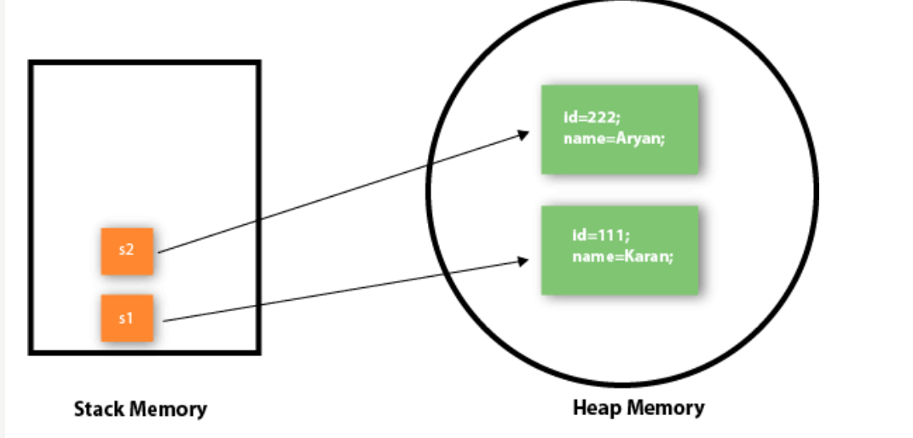
LAD

Slide 17
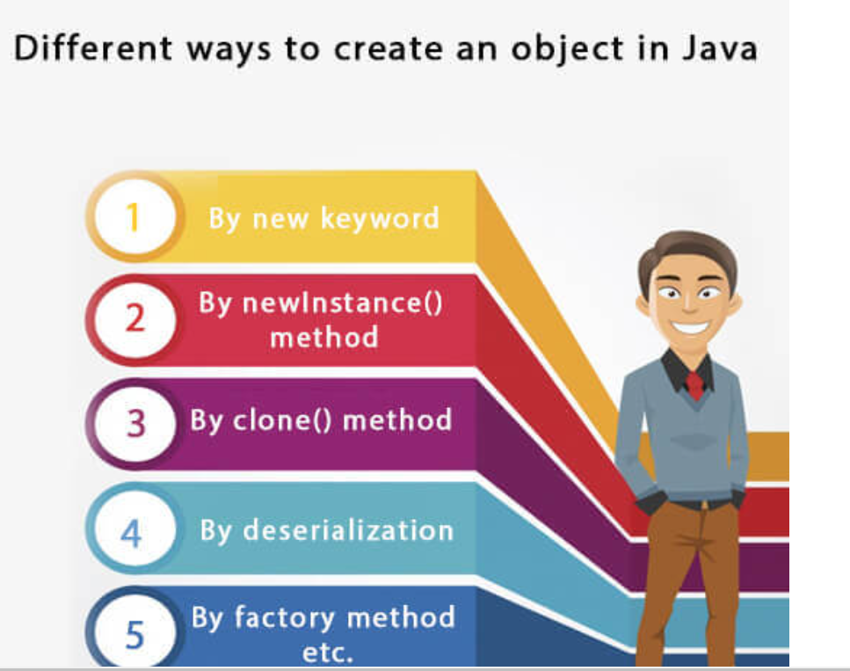
Create an Object
LAD

Slide 18
Anonymous Object
LAD
Anonymous simply means nameless. An object which has no reference is known as an anonymous object.
It can be used at the time of object creation only.
If you have to use an object only once, an anonymous object is a good approach. For example:
New calculation();//anonymous object
Calling method through a reference:
Calculation c=new calculation();
C.Fact(5);
Calling method through an anonymous object
New calculation().Fact(5);

Slide 19
Anonymous Object
LAD
Class calculation{
void fact(int n){
int fact=1;
for(int i=1;i<=n;i++){
fact=fact*i;
}
system.Out.Println("factorial is "+fact);
}
Public static void main(string args[]){
new calculation().Fact(5);//calling method with anonymous object
}
}

Slide 20
Creating multiple objects by one type only
LAD
We can create multiple objects by one type only as we do in case of primitives.
Initialization of primitive variables:
Int a=10, b=20;
Initialization of refernce variables:
Rectangle r1=new rectangle(), r2=new rectangle();//creating two objects

Slide 21
Creating multiple objects by one type only
LAD
Class rectangle{
int length;
int width;
void insert(int l,int w){
length=l;
width=w;
}
void calculatearea(){system.Out.Println(length*width);}
}
Class testrectangle2{
public static void main(string args[]){
rectangle r1=new rectangle(),r2=new rectangle();//creating two objects
r1.Insert(11,5);
r2.Insert(3,15);
r1.Calculatearea();
r2.Calculatearea();
}
}

Slide 22
Constructors in Java
LAD
In java, a constructor is a block of codes similar to the method.
It is called when an instance of the class is created.
At the time of calling constructor, memory for the object is allocated in the memory.
It is a special type of method which is used to initialize the object.
Every time an object is created using the new() keyword, at least one constructor is called.
It calls a default constructor if there is no constructor available in the class. In such case, java compiler provides a default constructor by default.

Slide 23
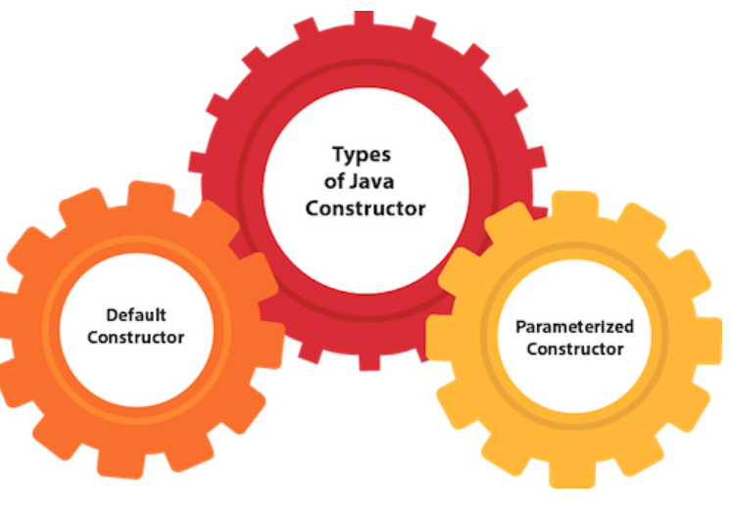
Constructors in Java
LAD
Rules for creating java constructor
There are two rules defined for the constructor.
Constructor name must be the same as its class name
A constructor must have no explicit return type
A java constructor cannot be abstract, static, final, and synchronized

Slide 24
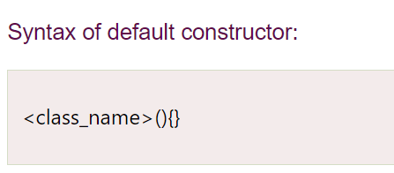
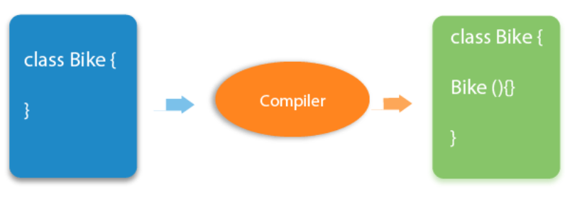
Constructors in Java
LAD
Default Constructor
A constructor is called "default constructor" when it doesn't have any parameter.

Slide 25
Constructors in Java
LAD
Parameterized constructor
A constructor which has a specific number of parameters is called a parameterized constructor.
The parameterized constructor is used to provide different values to distinct objects. However, you can provide the same values also.

